Slide 1
Nakuja Project
Avionics
Week 3 Progress Report

Slide 2
Tasks completed this week
[#30] Research on camera
ESP32 CAM test
FPV Camera test
[#1] ESP Wi-Fi data transmission test
[#2] Research on ground station

Slide 3
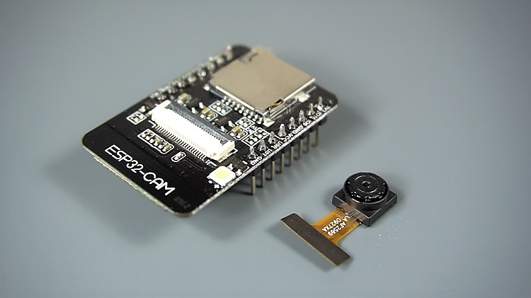
Research on camera
We found an ESP32 CAM module that communicates over WIFI Ip address
ESP32 cam uses OV2640 camera module-JPEG compressed image

Slide 4
ESP32 CAM Specifications
The smallest 802.11b/g/n Wi-Fi BT SoC module
Low power 32-bit CPU, can also serve the application processor
Up to 160MHz clock speed, summary computing power up to 600 DMIPS
Built-in 520 KB SRAM, external 4MPSRAM
Supports UART/SPI/I2C/PWM/ADC/DAC
Support OV2640 and OV7670 cameras, built-in flash lamp
Support image Wi-Fi upload

Slide 5
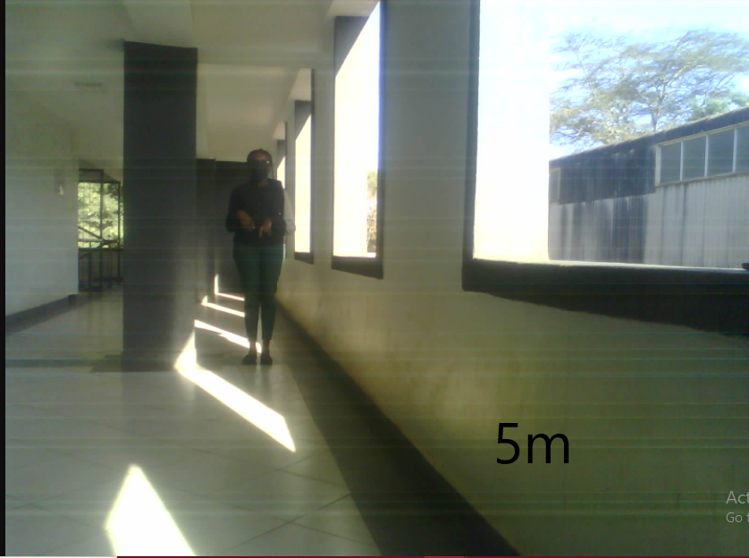
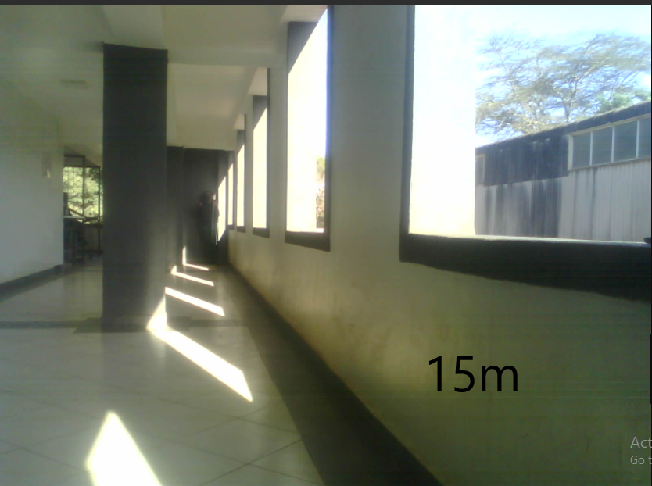
Test results
We conducted tests on video transmission over a range of 15m
Video results were received over IP address
Constrained by Wi-Fi Strength considering its operating over Wi-Fi
Good resolution up to distances of 5m. Beyond 15m, the camera lost its clarity

Slide 6
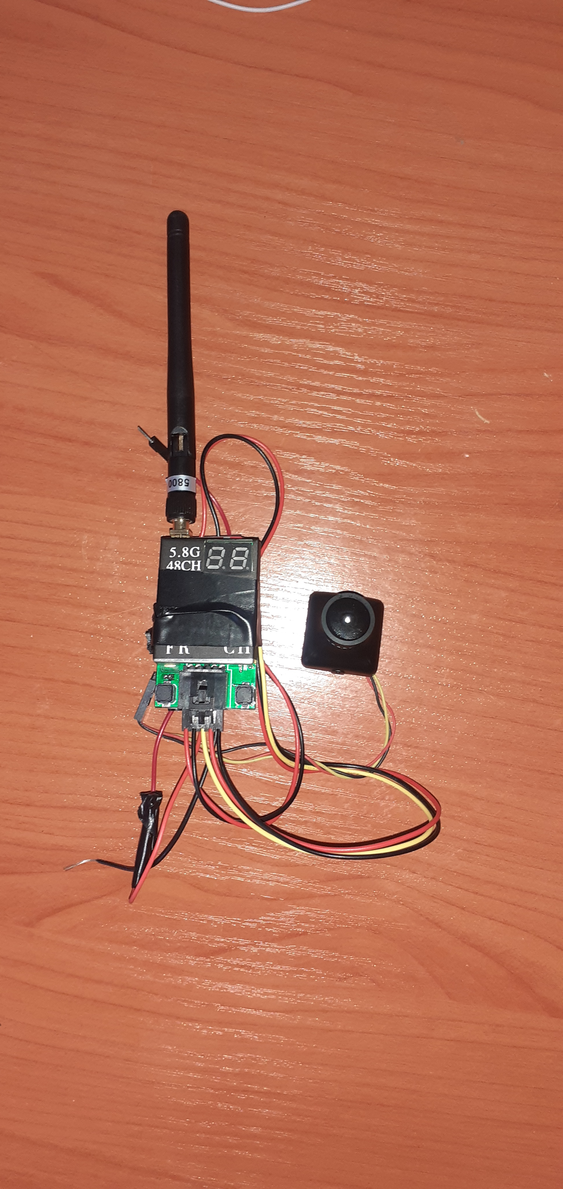
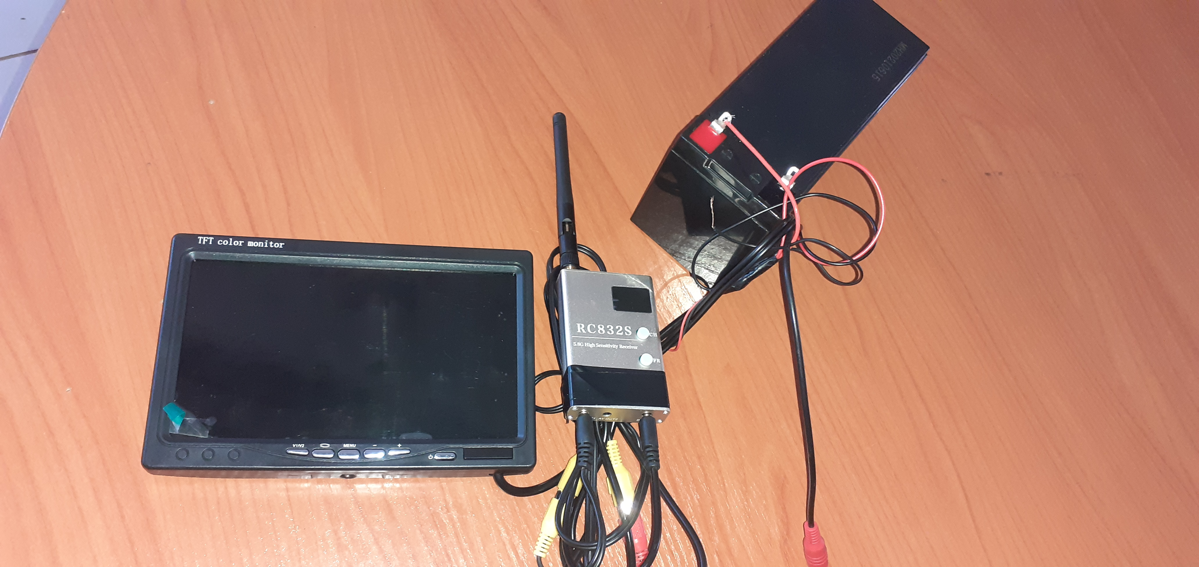
FPV Camera test
Transmitter
Receiver

Slide 7
Specs
Transmitter
Channels - 8
Frequency band - 2.4 – 6.8GHz
Receiver
Channels - 8
Frequency band - 2.4 – 6.8GHz

Slide 8
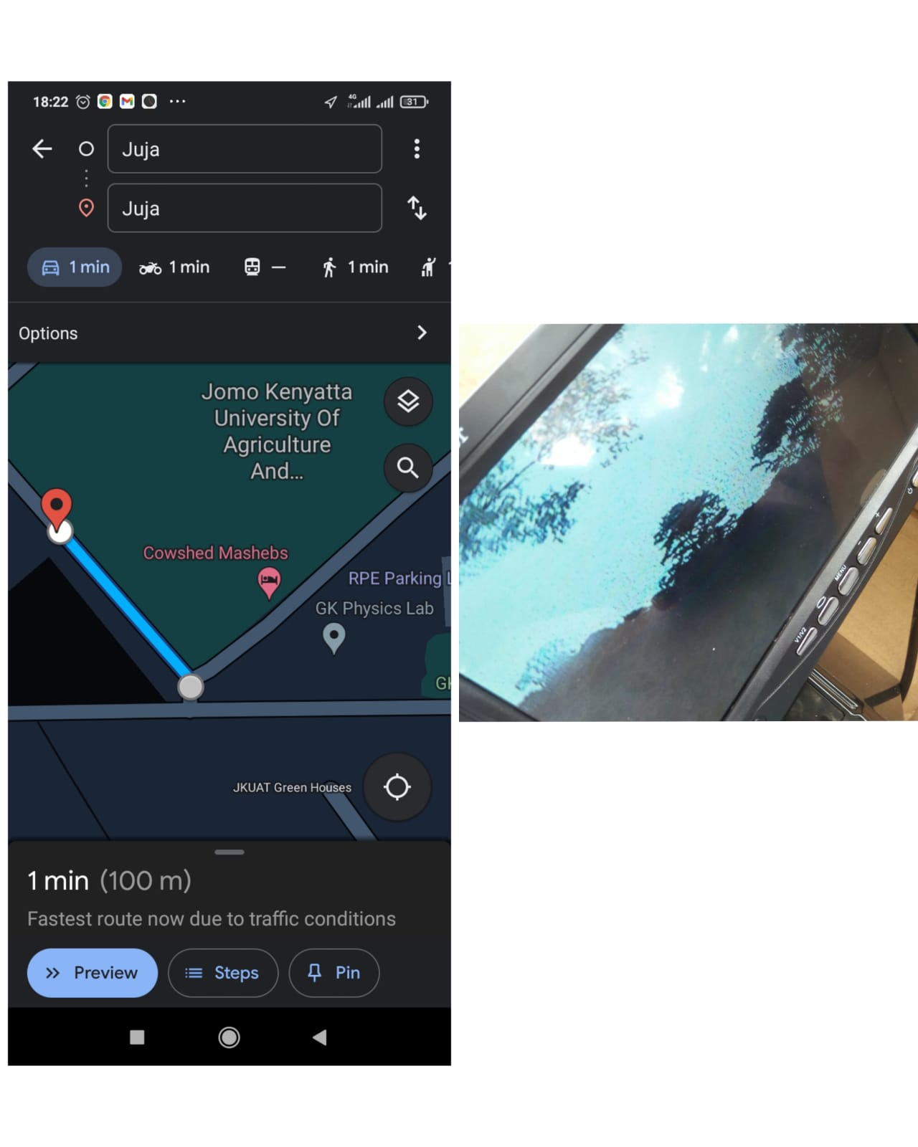
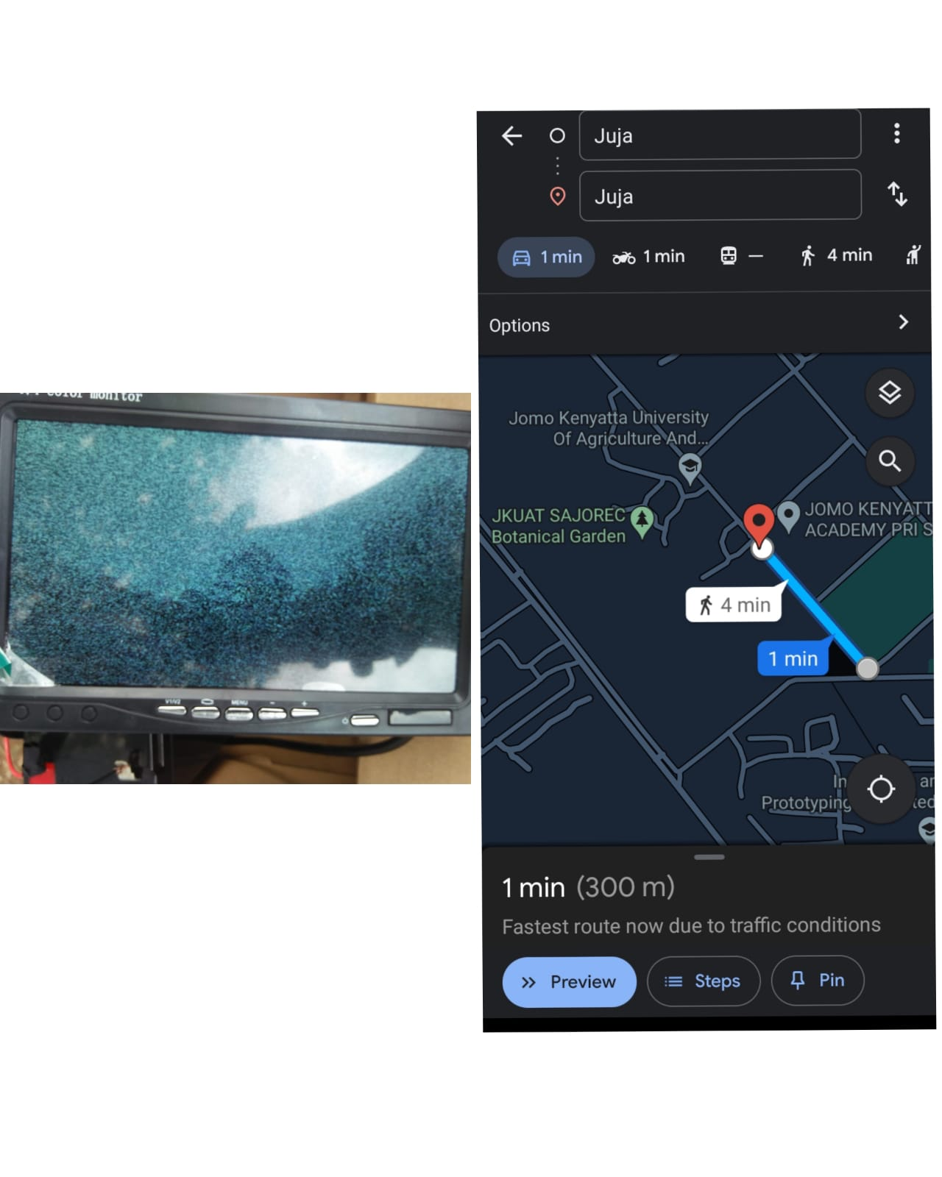
Test results Test site: Sajorec, Distance ~1.1km
100m
300m

Slide 9
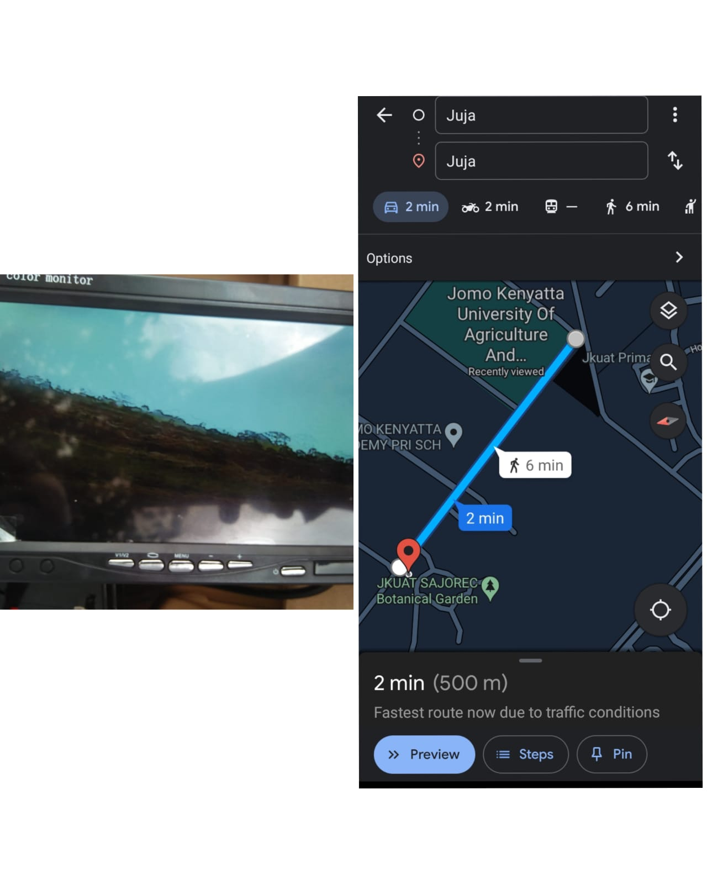
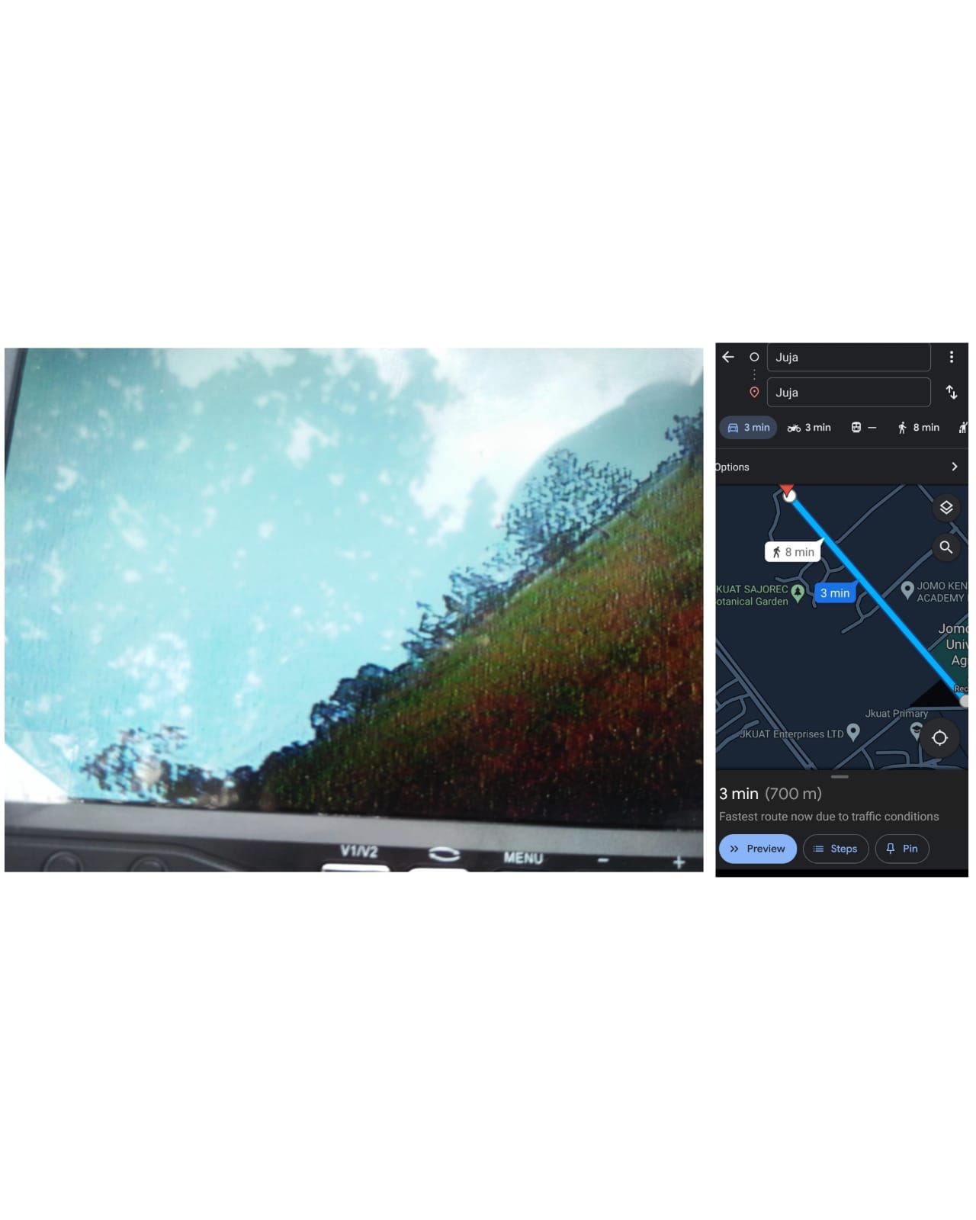
500m
700m

Slide 10
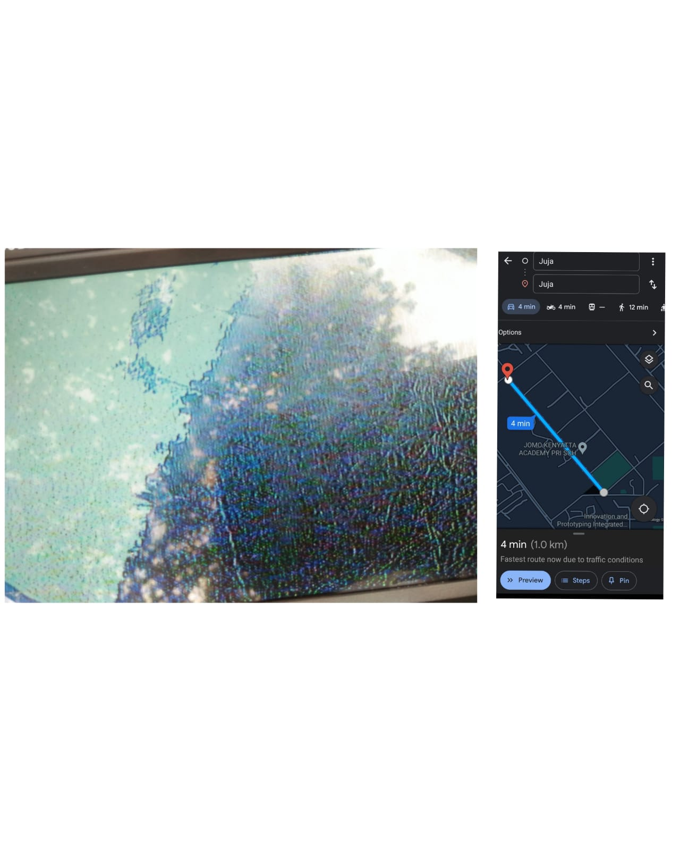
1km
Image started becoming grainy and pixelated at 1km

Slide 11
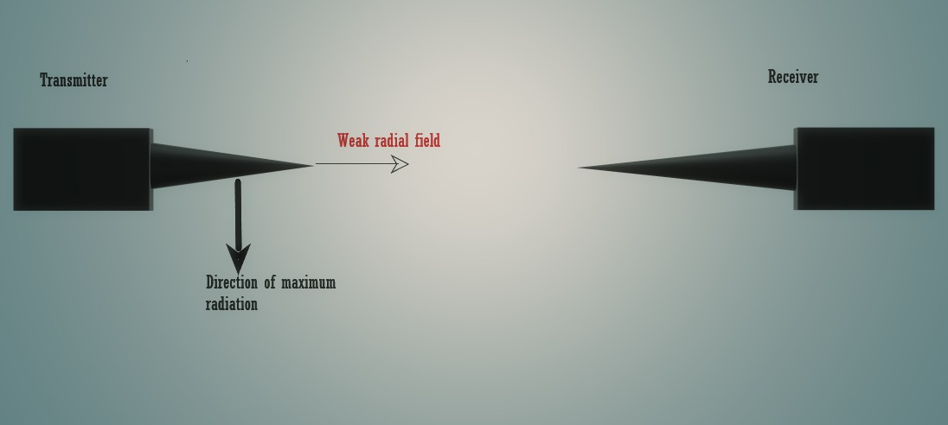
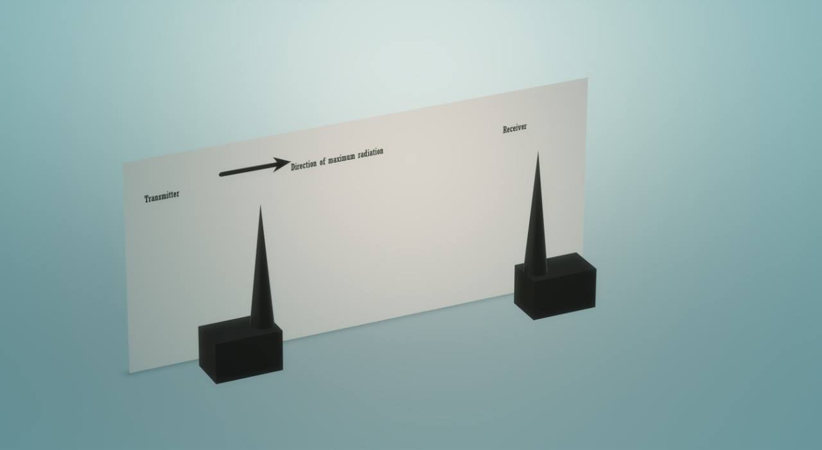
Concerns
Interference with other Wi-Fi frequencies especially ESP32 Wi-Fi
Solution: Operate FPV on a different frequency
Directivity
At 300m we noticed that when the antennas are pointed towards each other the video signal is degraded compared to when they are held upright

Slide 12
Concerns
Power usage
FPV transmitter uses 9-12 Volts. We intend to add a more powerful battery
Storage – Tweak the LCD-TFT receiver to include flight video storage

Slide 13
[#2] Research on ground station 1. Flight Data Recorder
Aim: Receive data from esp32 to Raspberry Pi Serial monitor
We were able to fetch data received from ESP32 to Raspberry pi via the serial monitor and store in a csv file with python
Advantage: Graphing, Storage and analysis for future optimization

Slide 14
Task this week
[#23] Avionics bay design
[#1] Wi-Fi Antenna design for range extension
[#2] Dashboard design
[#31] Apogee detection
[#26] Improve Kalman filter performance

